Slide 1

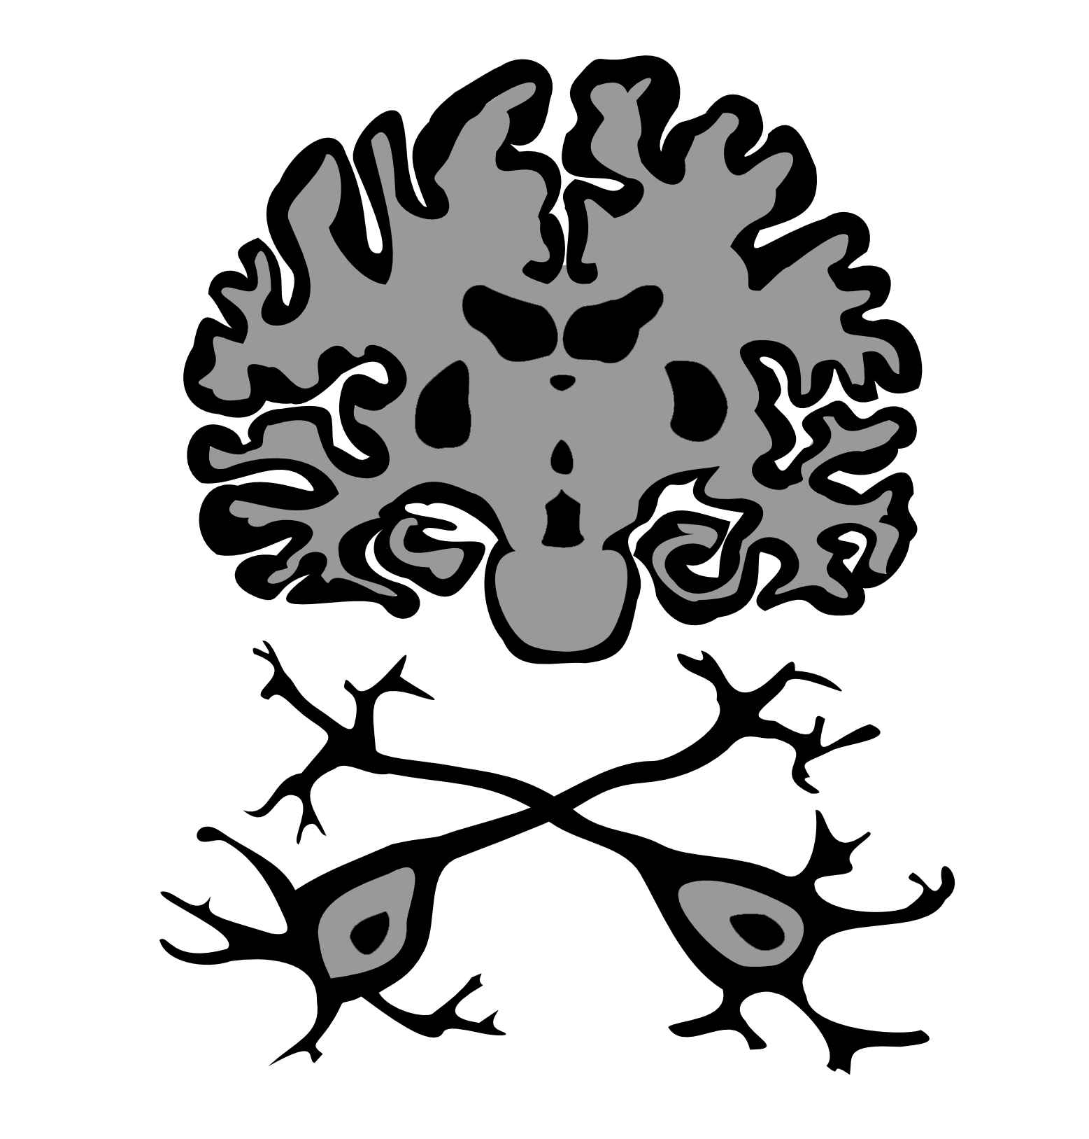
Layer-dependent Functional Connectivity Methods
Richard Klein, Peter Bandettini
Notes:
Hi, My name is Richard Klein.
I was working with Dr. Bandettini at NIH on functional connectivity methods using laminar fMRI.

Slide 2
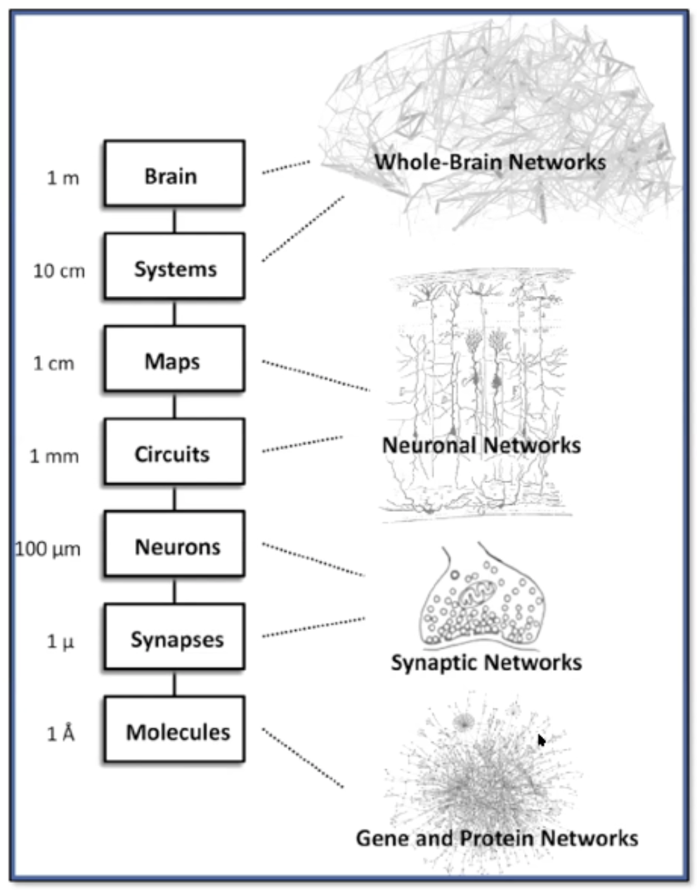
Bandettini IEEE Brain Presentation
Notes:
So, just to motivate laminar fMRI.
So brain is very complex and it’s organized across many different spatial and temporal scales.
Using fMRI we can evaluate the brain at the macroscopic level, so “whole brain” perspective, a “systems” perspective, and even “maps” (visual retinotopy), down to a about a centimeter.
There are also cellular/molecular/ephys/optogenetic methods that are very precise but are usually invasive involving animal models and are limited to neurons or small groups of neurons.
And so if we are interested in getting a more comprehensive picture of how the brain functions we need something that is both whole brain and offers a high level of specificity.
And so in particular neural activity at the circuit level has a lot of really interesting information and unique signatures that could help explain what's going on.

Slide 3
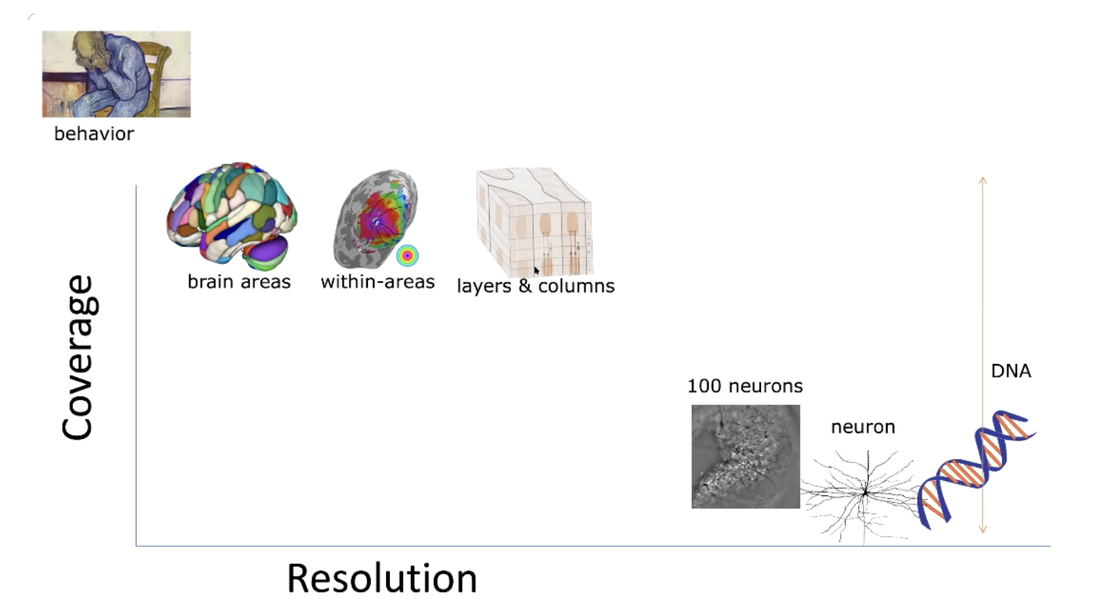
Bandettini IEEE Brain Presentation
Notes:
And so this just a plot of coverage by resolution, and we see that laminar fMRI maintains the whole brain coverage afforded by fMRI, but also high enough resolution that we are able to measure these circuit, layers, and columns.

Slide 4
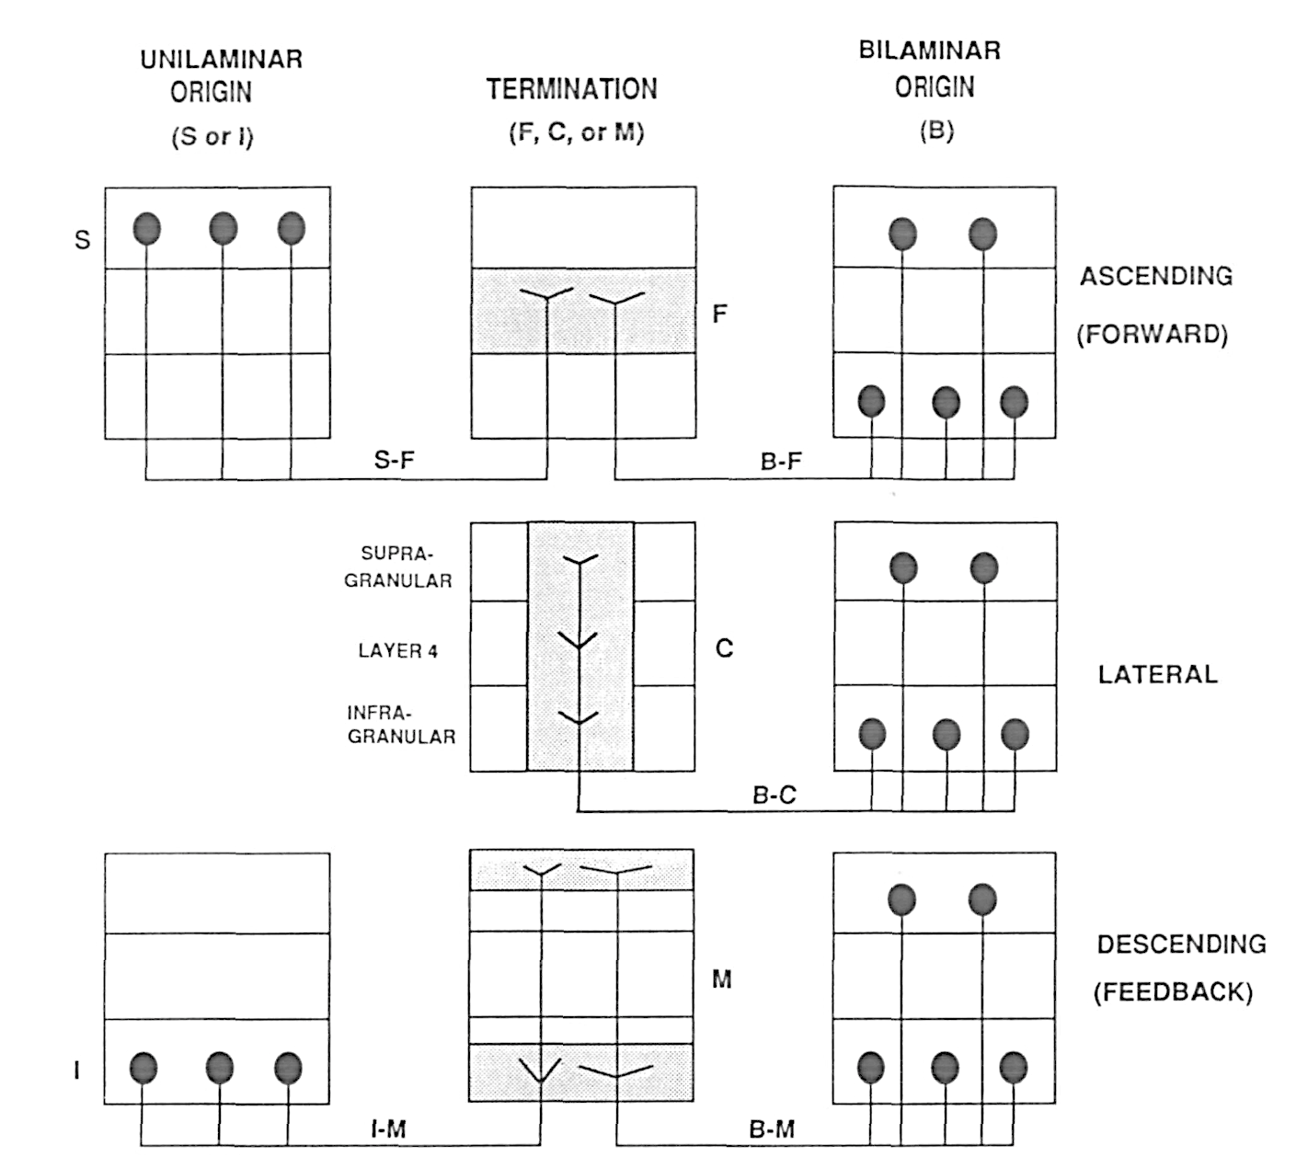
Why layers and columns?
Layer connectivity provides directionality
Feedforward connections terminate in middle layers
Feedback connections terminate in superficial and deep layers
Lateral connections terminate in superficial, middle, and deep layers
Felleman, D. J., & Van Essen, D. C. (1991). Distributed hierarchical processing in the primate cerebral cortex. Cerebral Cortex
Notes:
So why are we interested in layers and columns?
So basically, layer connectivity provides us with this measure of directionality between ROIs.
feedforward connections terminate in middle layers
feedback connections terminate in superficial and deep layers
lateral connections terminate in deep, middle and superficial layers.
And these proposed connectivities come from a paper by Felleman and Van Essen where detail the canonical micro-circuit hierarchical connectivity in early visual cortex

Slide 5
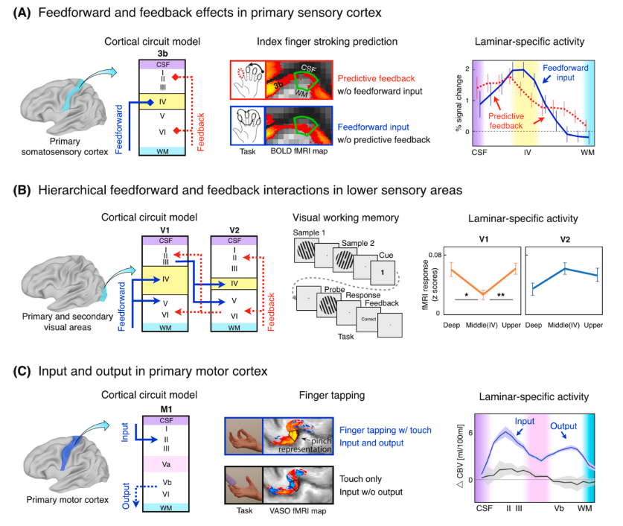
Why layers and columns?
Yang, J., Huber, L., Yu, Y., & Bandettini, P. A. (2021). Linking cortical circuit models to human cognition with laminar fMRI. Neuroscience & Biobehavioral Reviews
Notes:
﻿And so I include this slide just to make the point that although Felleman and Van Essen describe the connectivity in the early visual system, this does not necessarily apply to other areas of the brain
And so M1 for instance receives input in superficial layers and output is in the deep layers
Also the size of different layers in different areas of the cortex may vary which could impact some of our analyses

Slide 6
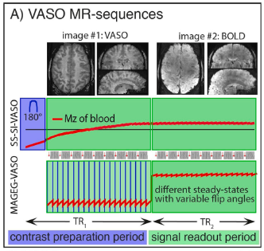
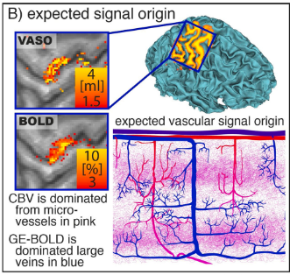
How do we assess functional connectivity?
Vascular-Space-Occupancy (VASO) fMRI
VASO detects changes in cerebral blood volume (CBV)
VASO is selective for homogenously distributed micro-vessels along the GM ribbon
Double-stripe effect
Notes:
So how do we assess functional connectivity?
Well you need the data first.
And so there are a couple of different sequences you can use to get laminar data, each with pros and cons, but the data I’m working with is 7t whole brain VASO--vascular space occupancy fmri
VASO detects brain activation based on changes in Cerebral Blood Volume (CBV), as opposed to conventional BOLD fMRI, which is based on changes in blood oxygenation.
VASO sequence alternates between acquiring a blood nulled volume and then a conventional BOLD contrast.
In preprocessing we divide the blood nulled contrast by the BOLD contrast to produce the final VASO volume.
This technique makes VASO very specific to these micro-vessel beds. BOLD has a tendency to select for the large draining vessels.
This is a nice property because microvessels are homogenously distributed throughout the grey matter ribbon.
VASO is so specific for these micro-vessel beds you can see this double stripe effect.
https://www.youtube.com/watch?v=dcmB2h4pIs4

Slide 7
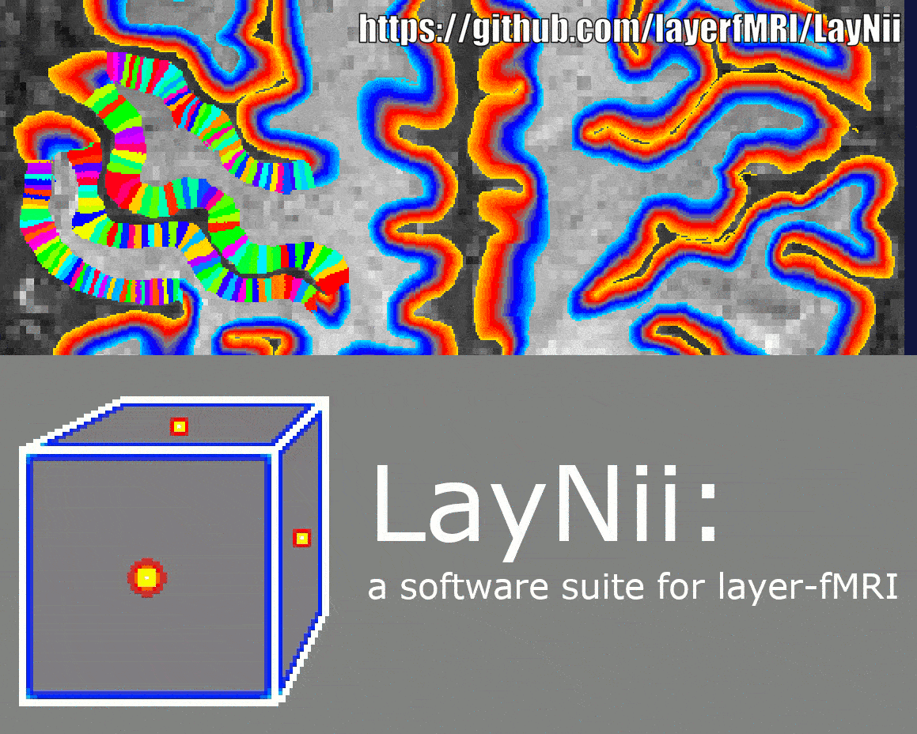
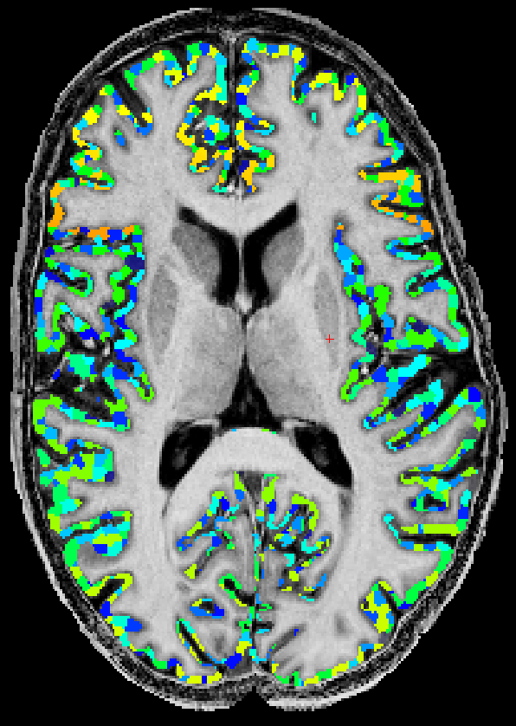
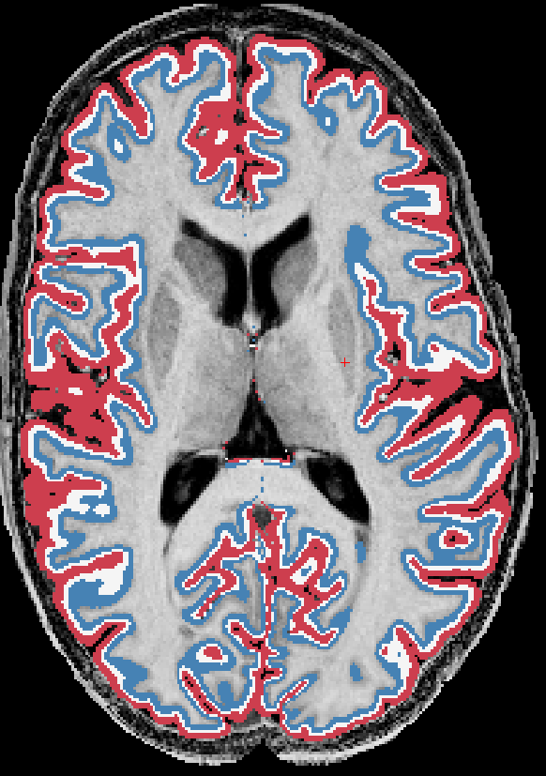
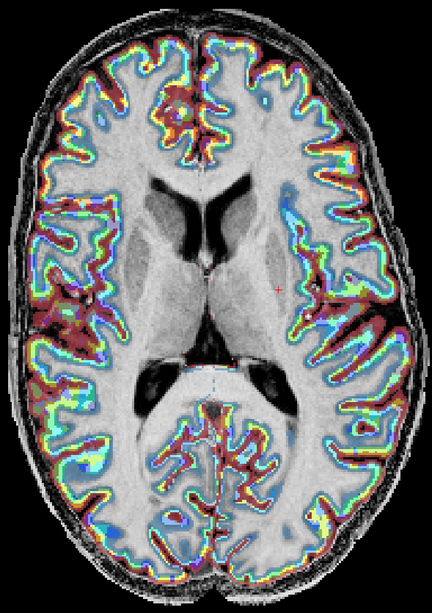
How do we assess functional connectivity?
Building Layers and Columns
x
=
Notes:
So now we have the data, we have extract it?
So here are the anatomical scans, Ithey’ve been segmented in freesurfer, segmentations manually corrected, and I built out the layers and columns using laynii package.
So in the first panel I have 1000 columns. Admittedly, I’ve mainly been using the hcp multimodal parcellation with 360 ROIs to limit the number of correlations
In the second panel I have 3 layers within the Grey Matter ribbon.
Third panel is the intersection of the two
And so we can use the intersection of the columns and rois to extract timeseries data from the VASO runs and do our analysis.

Slide 8
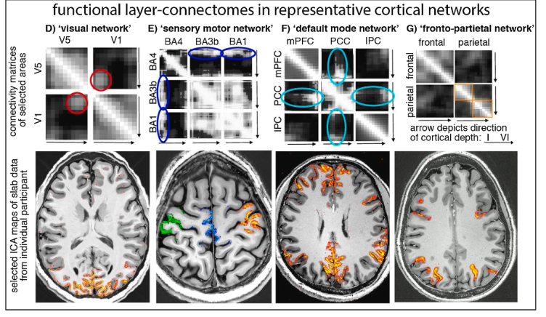
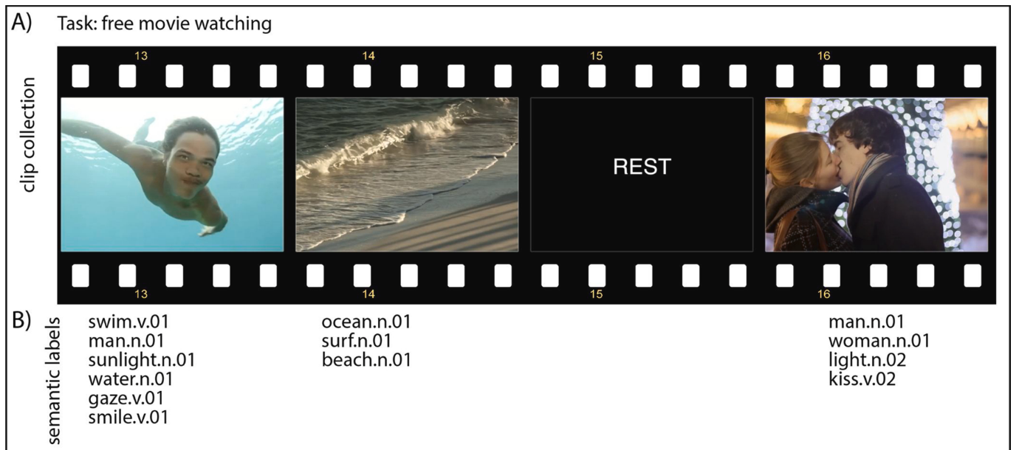
Functional Connectivity Analysis
Movie-watching
ICA to isolate networks of interest
Functional connectivity between layers of ROIs using VASO data
Huber, L., Finn, E. S., Chai, Y., Goebel, R., Stirnberg, R., Stöcker, T., … Poser, B. A. (2020). Layer-dependent functional connectivity methods. Progress in Neurobiology, (May).
Notes:
The analyses that I have been working on are trying to replicate the results of Renzo Huber’s that I have included here. Renzo was a post-doc in Dr. Bandettini’s lab. He’s done a lot of the laminar fMRI work including working with the VASO pulse sequence and writing laynii package.
We’re both working with movie-watching datasets, using hcp’s standard set of movie clips
Renzo performed ICA on hcp’s BOLD 7t dataset to isolate these 4 networks, visual network, sensory motor network, default mode network and fronto-parietal network.
Using these netowrks as seed networks he conducted a layer connectivity analysis using the VASO data.
I'm pretty much attemting to duplicate this using my VASO dataset.
And so here is some data by Renzo Huber. He was a post-doc in Dr. Bandettini’s lab. And thus far I’ve just been working on reproducing some of his results. Renzo used 7t moie-watching data hcp dataset to extract these networks using ICA.
and extracted these networks using ICA..
So he has a visual network, sensory motor network, default mode network, and fronto prarietal network.
And so using those networks as seeds used the VASO data to assess the layer connectivity.

Slide 9
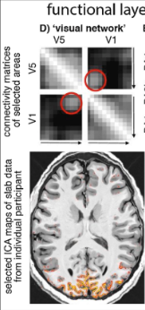
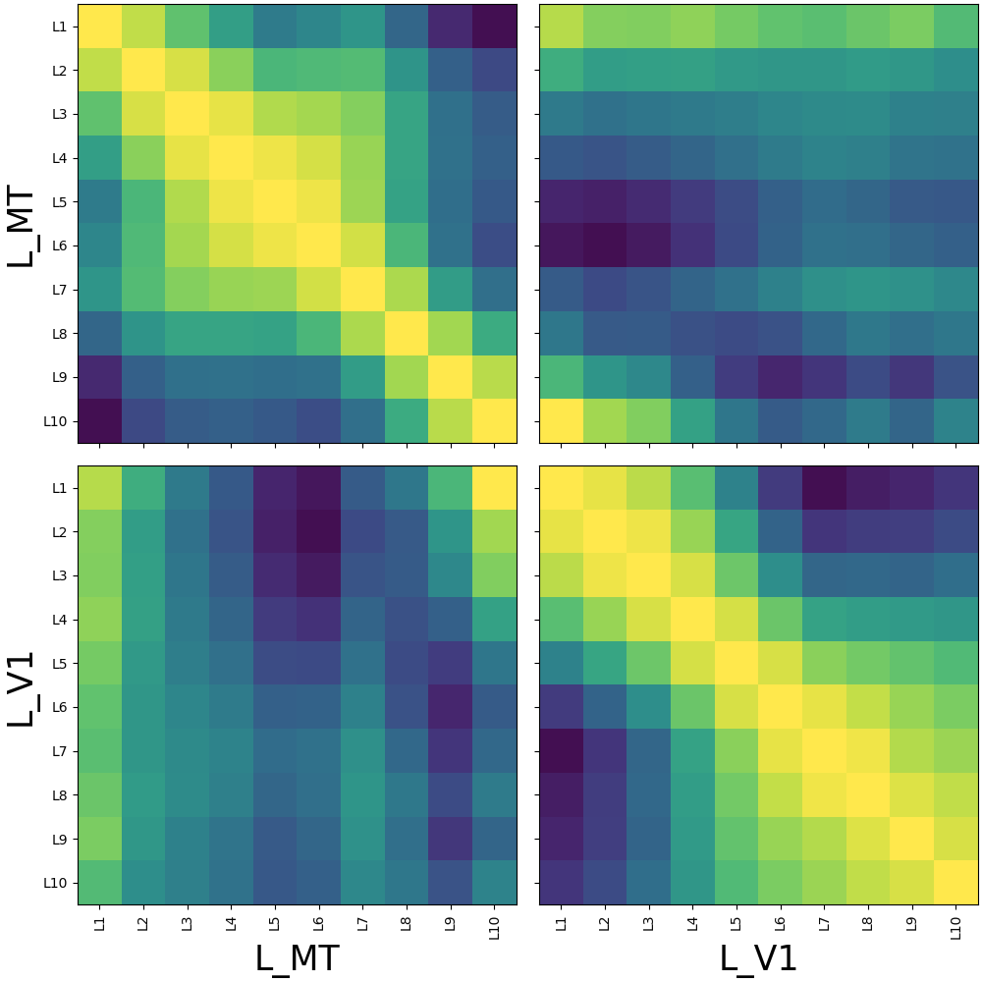
Visual Network
V1 receives top-down feedback in superficial layers from V5/MT, while V5/MT receives bottom-up input in the middle/deeper layers
Visual Network (L_V1 L_MT)
Notes:
And so here V1 receives top down feedback in superficial layers from V5 (MT) and V5 (MT) receives bottom up in the middle and deep layers

Slide 10
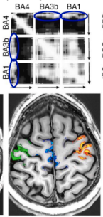
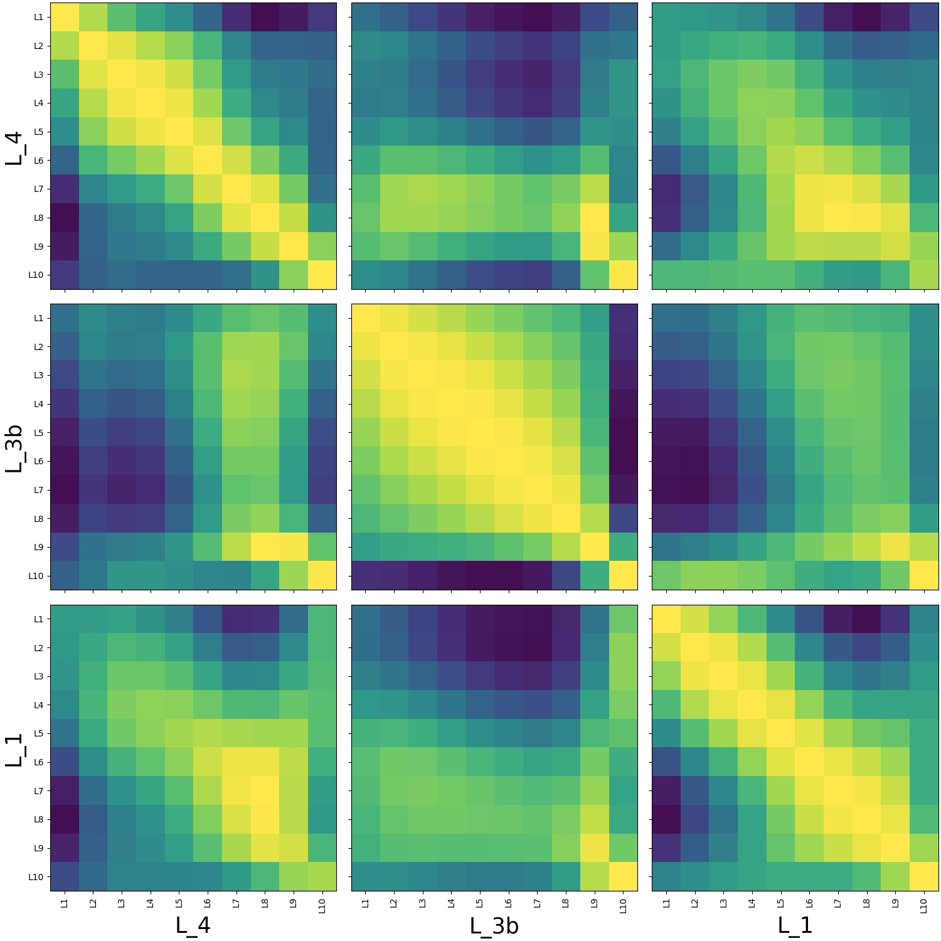
Sensory Motor Network
Primary motor cortex receives input from the sensory areas solely in superficial layers
We get correlations with middle/deeper layers of BA4. We would expect more superficial correlations (layer misalignment)
Sensory Motor Network
(L_4, L_3b, L_1)
Notes:
Primary motor cortex receives input from the sensory areas solely in superficial layers
And so we don’t get that here but is likely due to poor alignment between the anatomical and VASO volumes. I was using an average of the VASO runs and each VASO run actually requires it’s own unique transformation due to the heavy 7T warping, and I haven’t regenerated these plots.

Slide 11
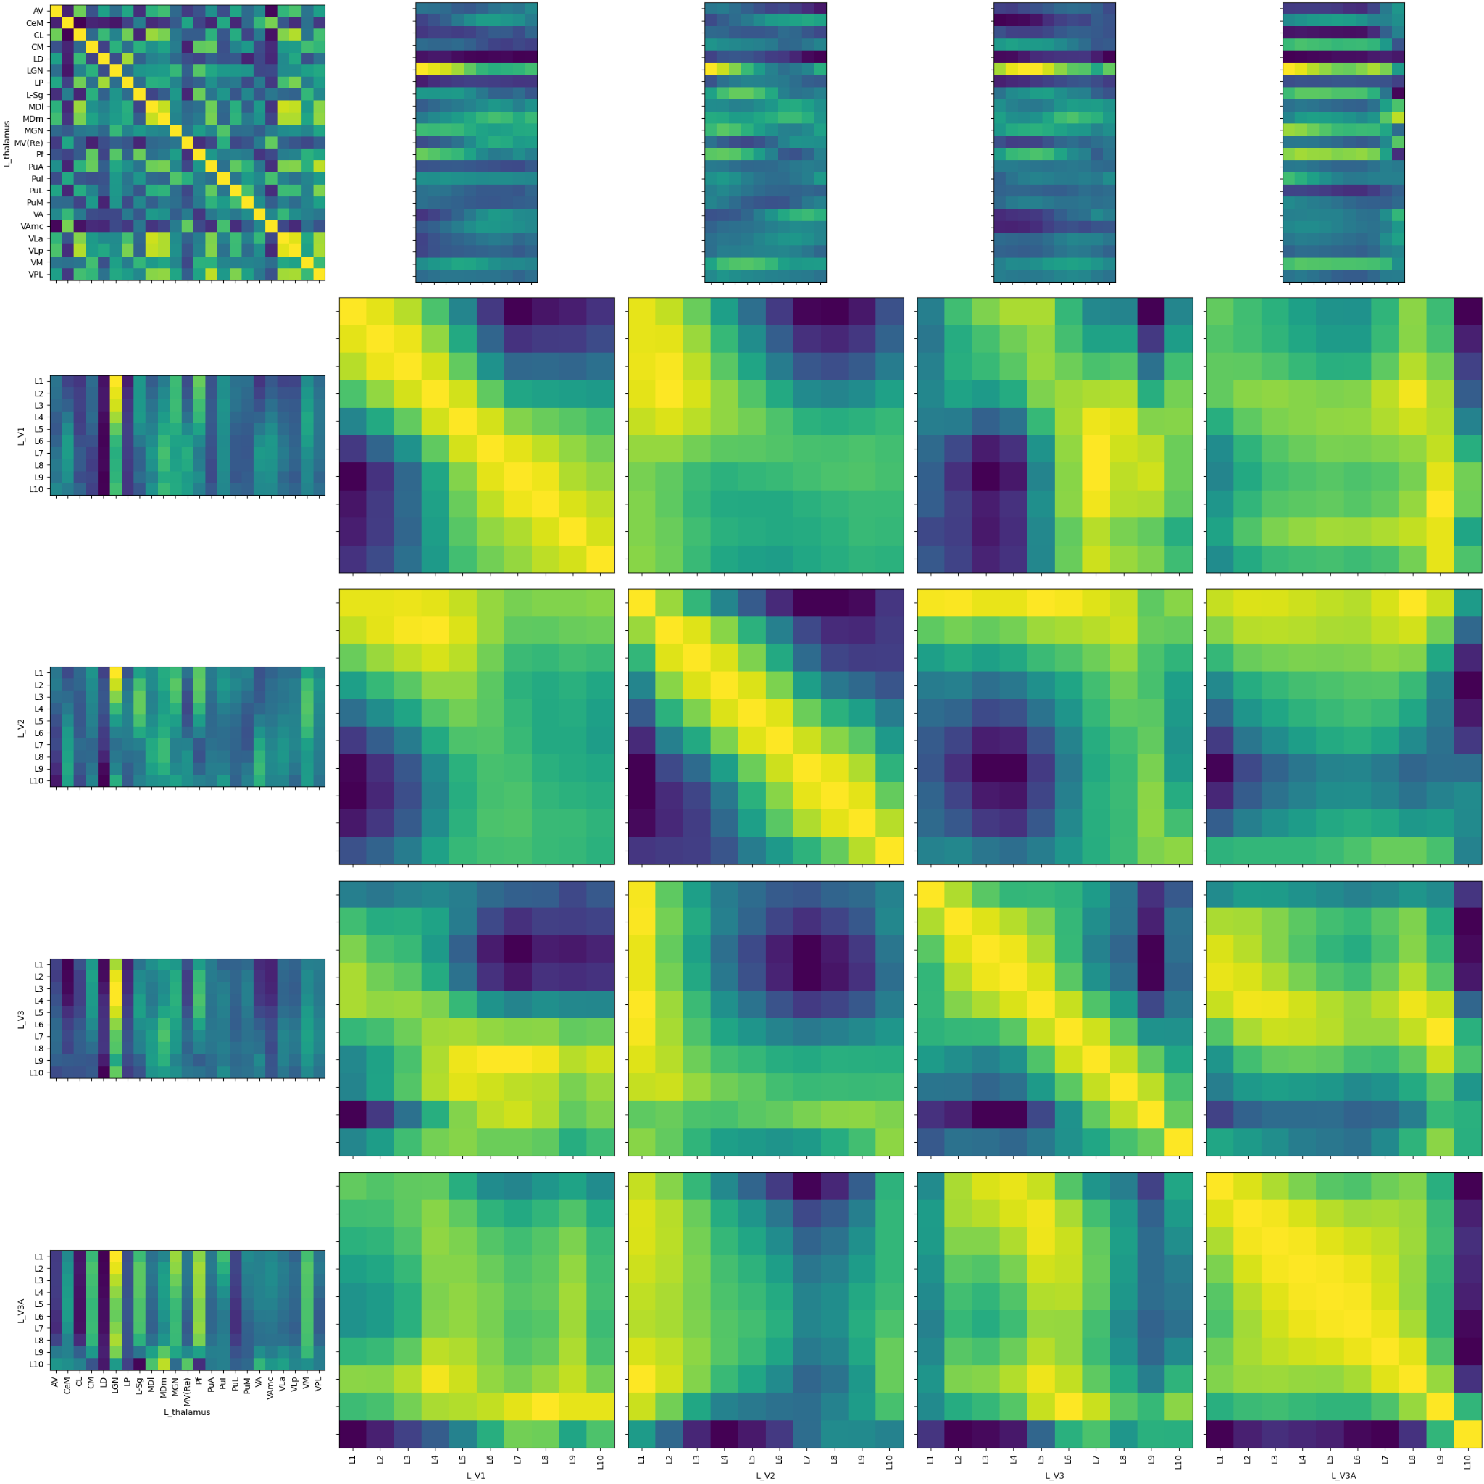
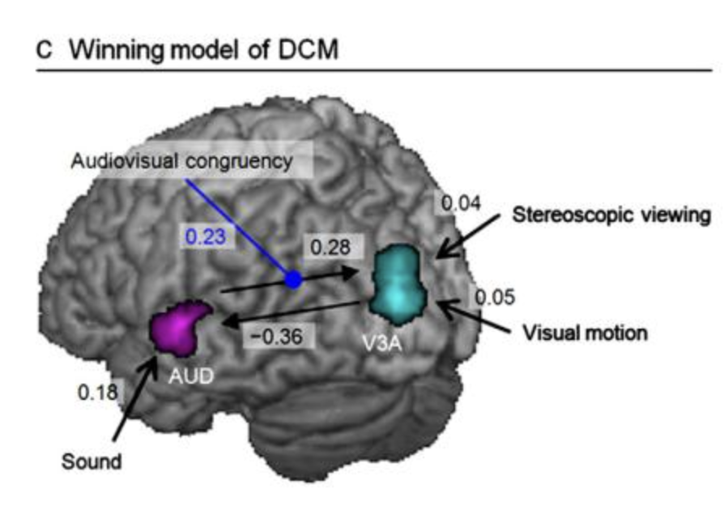
Audio-visual interactions in Area V3A
LGN correlates with superficial layers of the early visual ROIs, we would expect middle layers (layer misalignment?)
Interestingly, V3A may be getting some auditory input (slight correlation with MGN)
“﻿Changes of visual size and auditory intensity provide us with the main cues about motion direction in depth”
LGN
L_V3A L_V3 L_V2 L_V1 L_Thalamus
Ogawa, A., & Macaluso, E. (2013). Audio-visual interactions for motion perception in depth modulate activity in visual area V3A. NeuroImage
MGN
Notes:
So here I included a thalamic parcellation with a bunch of the nuclei in particular LGN and MGN, early visual ROIs including V1, V2, V3, V3A.
And so it looks like we get some correlation between LGN and V1, V2, V3, V3A. And I believe this has been reported elsewhere.
I thought though that the slight increase in correlation between MGN and V3A was interesting. And so I don’t think MGN is connected to V3A (?) but there might be some intermediate auditory region (?)
Apparently there is some evidence, I think, for audio-visual interaction in V3A, specifically with regard to visual and auditory motion direction in depth.
Partial correlations

Slide 12
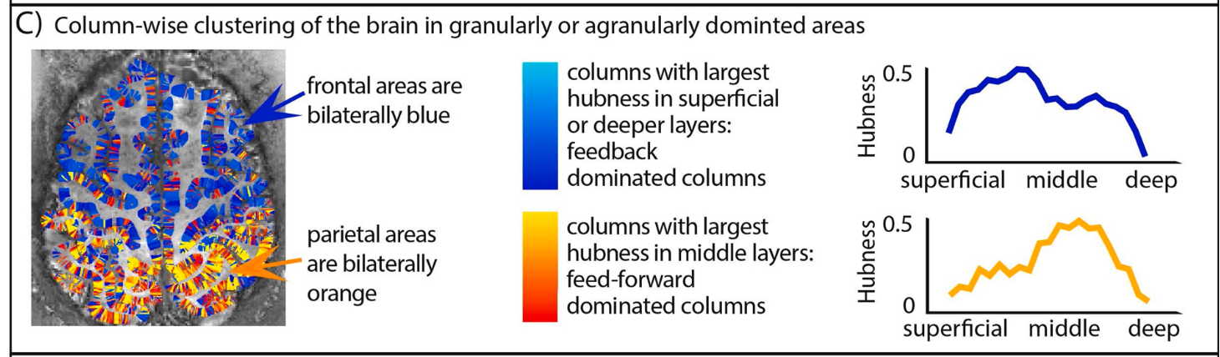
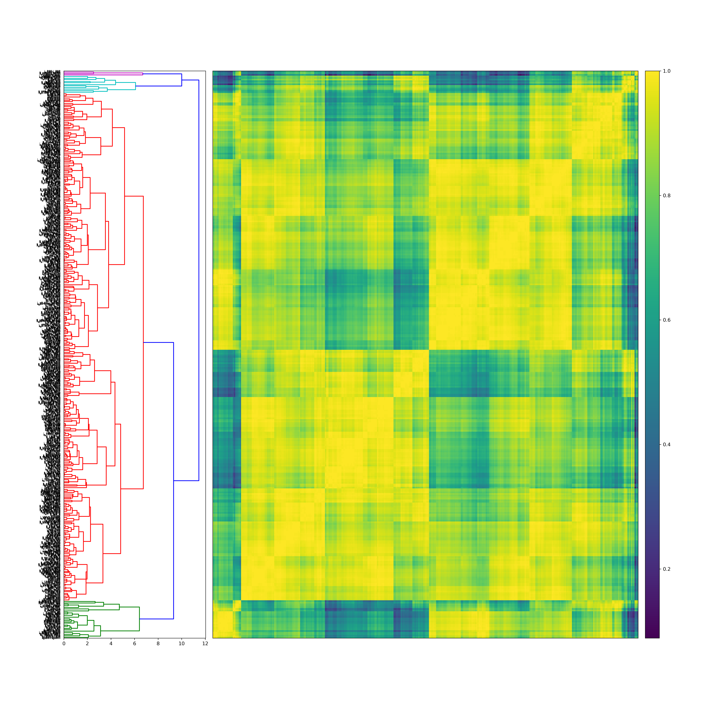
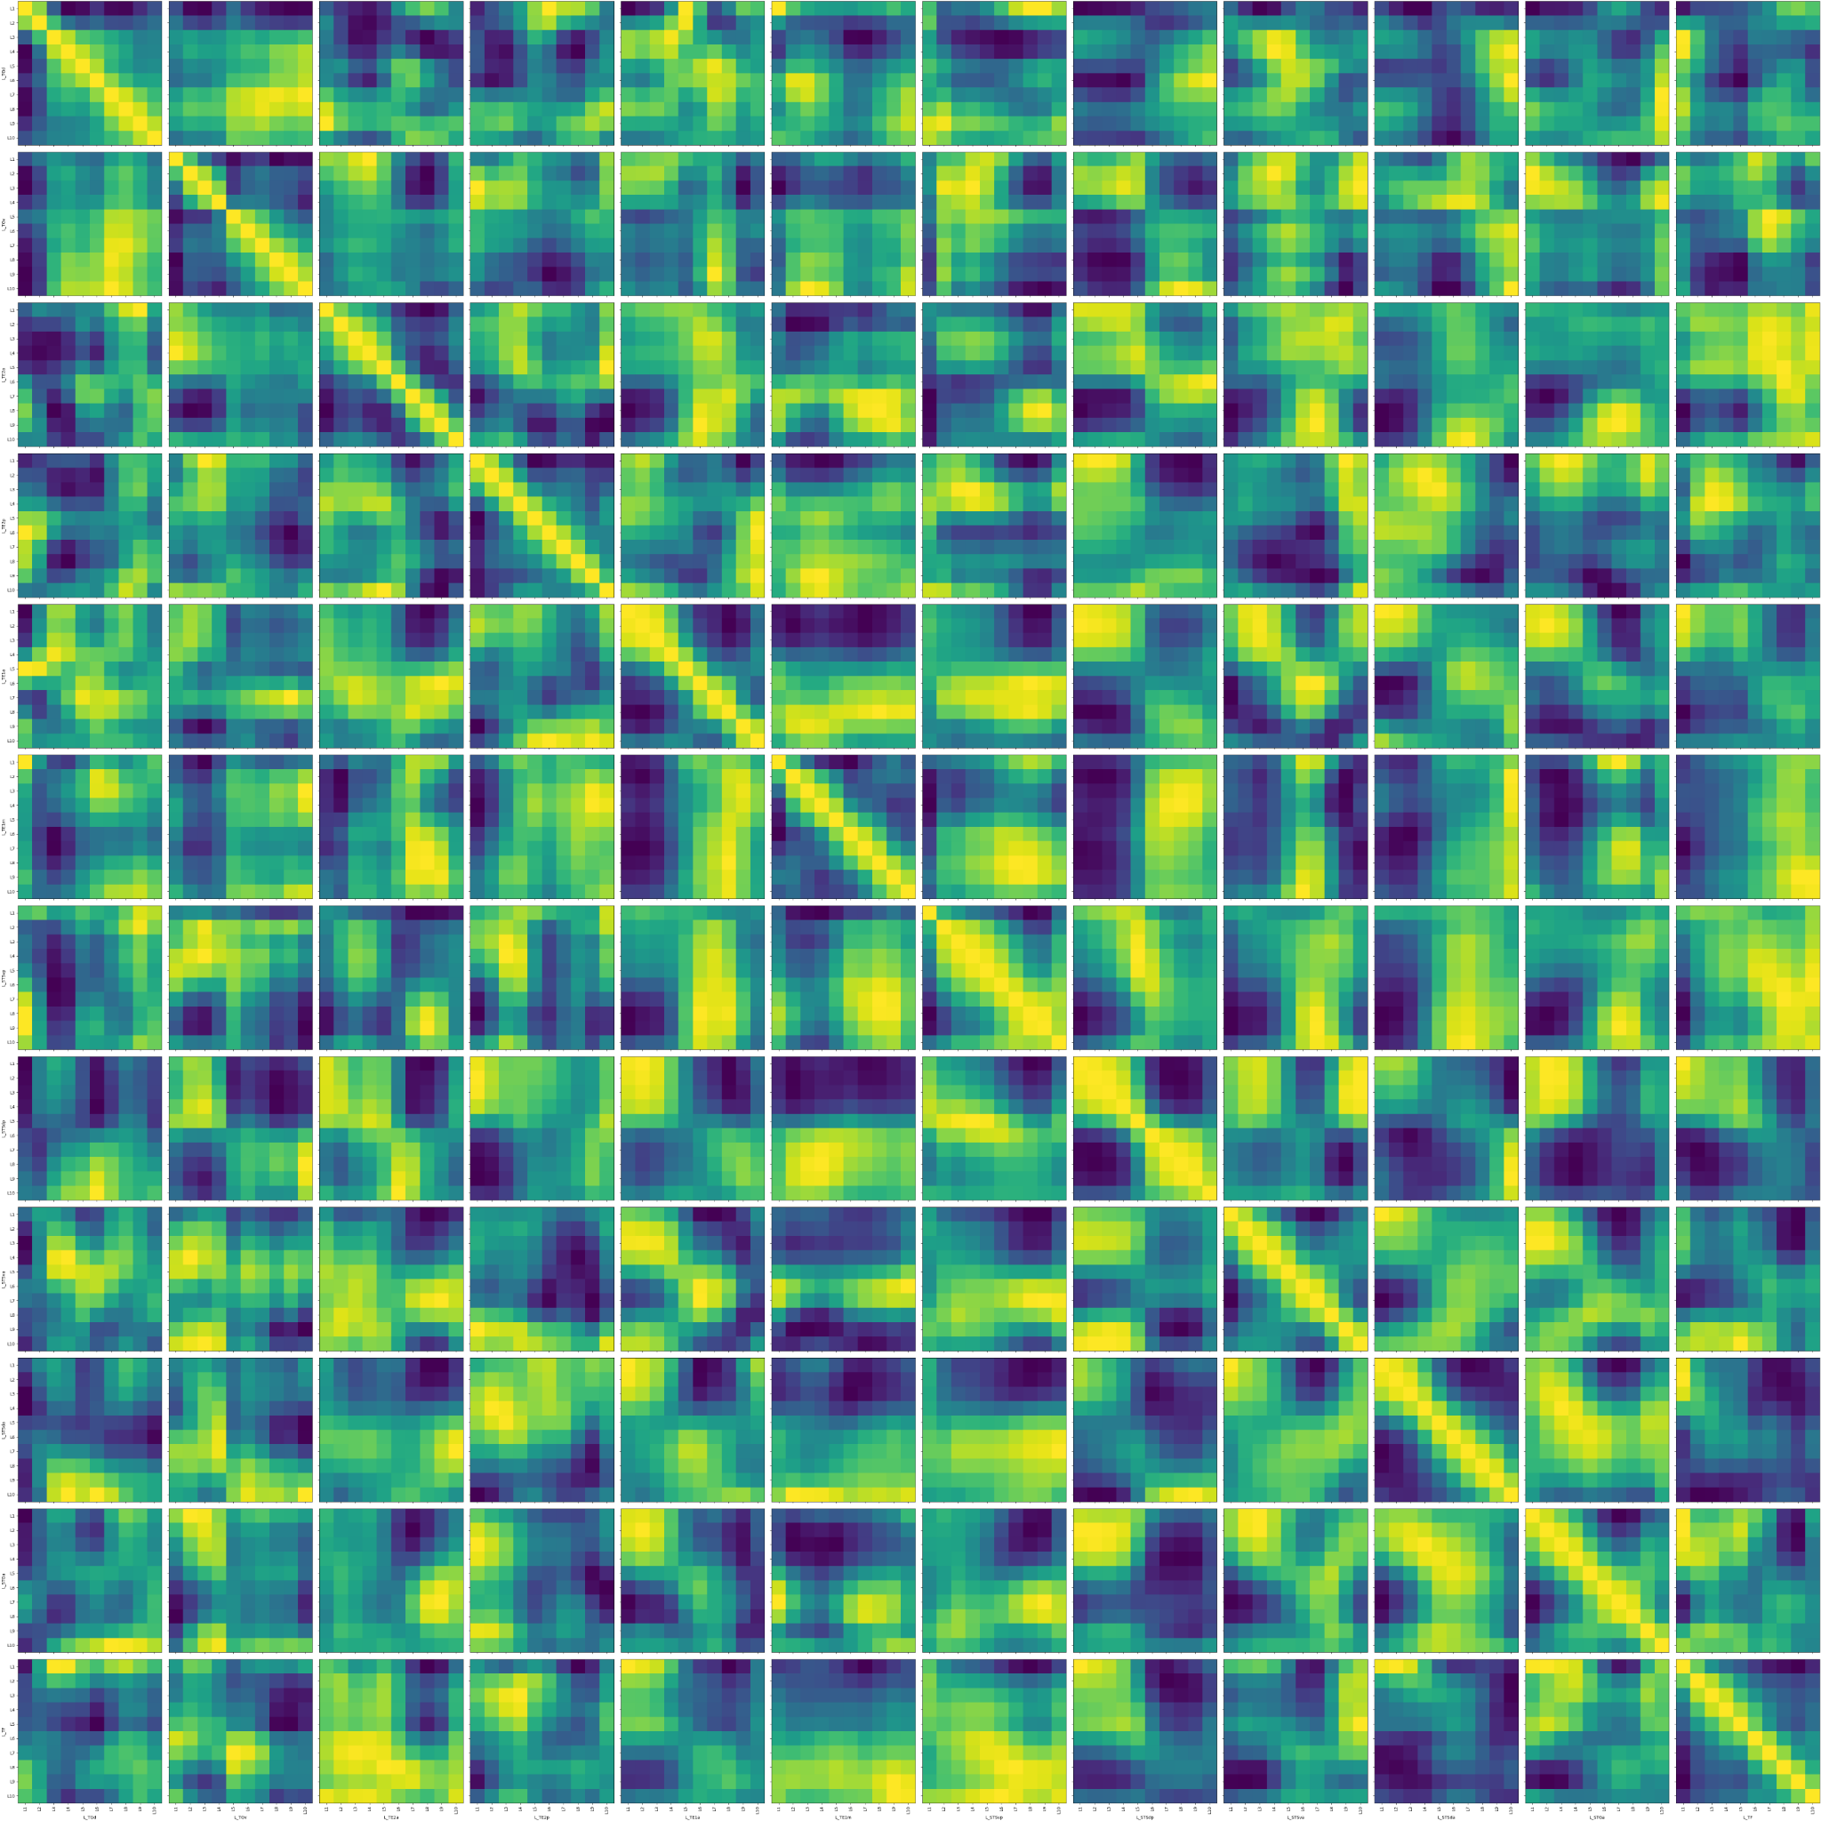
Clustering Nodes
360 nodes
We expect 2 major node clusters:
Feedforward dominant
Feedback dominant
Notes:
In this analysis we are correlating each layer with every other layer within a single column. We are looking for the dominant layer within each column—that is, the layer that every other layer correlates with.
If the dominant layer is a middle layer we consider the column to be feedforward column
and if the dominant layer is a superfical or deep layer we consider the column to be a feedback column
And so Renzo’s here he saw that frontal regions tended to be feedback, while posterior regions tended to be feedforward.
So that's also what we do. We cluster the eye of matrix, so the within ROI correlations, and we do also seem to get two big clusters. I haven’t been able to dig into this and investigate what exaclty we are clustering

Slide 13
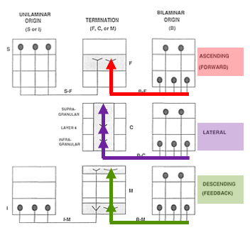
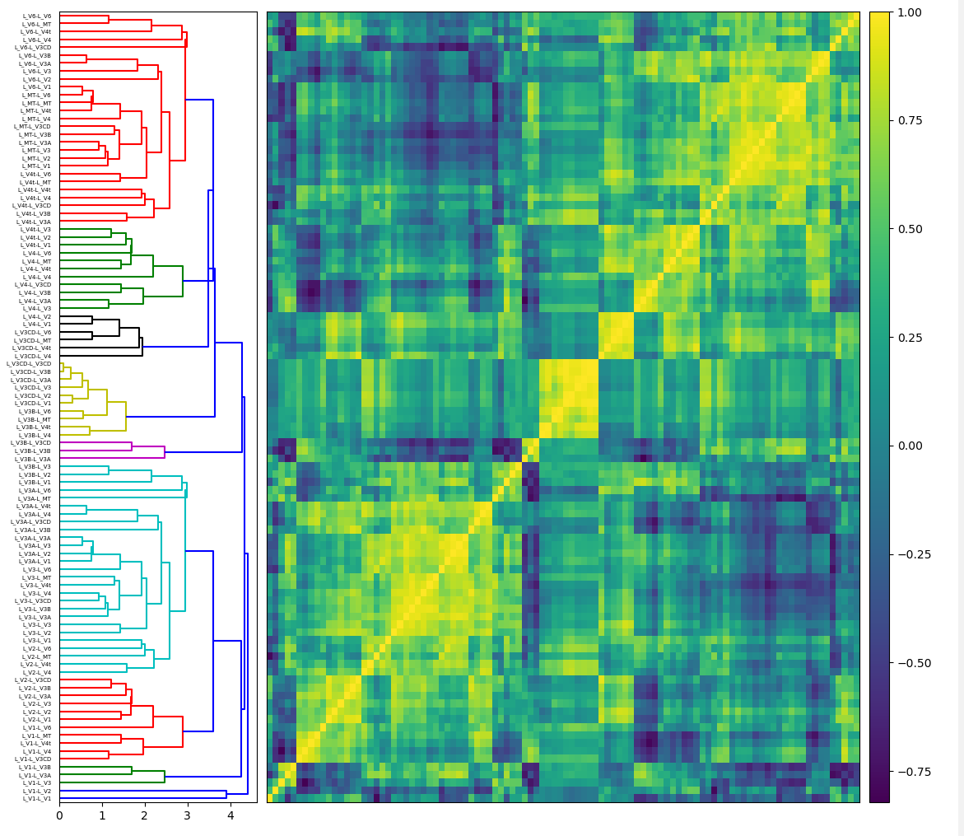
Clustering Edges
66 edges (64620 edges total!)
We would expect at least 3 clusters: feedforward, feedback, and lateral. More if connectivities differ from those proposed by Felleman and Van Essen.
Notes:
same idea here we are clustering the correlations between different ROIs.
I’m not doing whole brain but only 11 early visual ROIs.
The expectation would be to have at at least three clusters as proposed by felleman and van essen, but we might have more if the connectivities occur between different layers or the layers are positioned at sufficiently different depths within the grey matter. Anything that might make those correlation matrices look different.
It looks like we get a bunch of different clusters, but I haven’t had a chance to dig into this and figure out why they are different.

Slide 14
Thank You
Peter Bandettini
Tyler Morgan
Burak Akin
Kathleen Maguire-Zeiss
John VanMeter
Notes:
I wanted to thank Dr. bandettini, and Dr. Maguire Zeiss and Dr. VanMeter for letting me do this. Also thanks to m y cohort and IPN program.

Slide 15
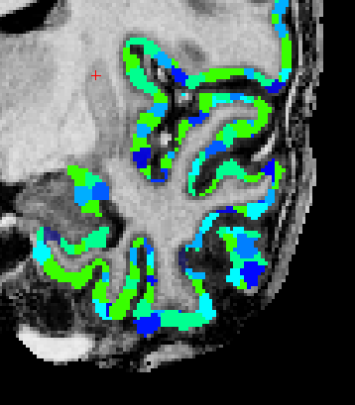
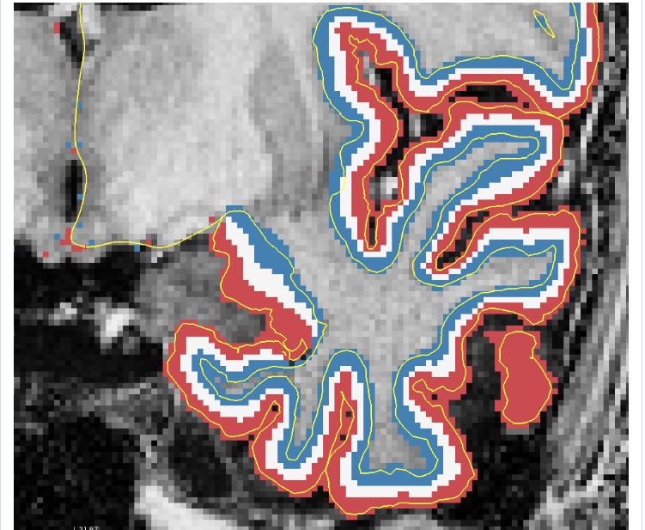
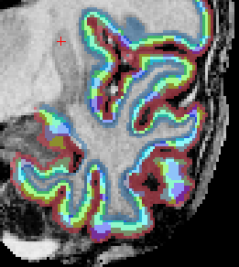
How do we assess functional connectivity?
x
=

Slide 16
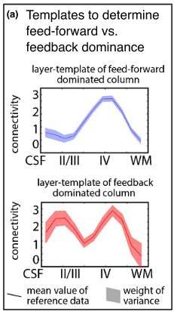
Movie-watching Functional Connectivity
Huber, L., Finn, E. S., Chai, Y., Goebel, R., Stirnberg, R., Stöcker, T., … Poser, B. A. (2020). Layer-dependent functional connectivity methods. Progress in Neurobiology, (May).

Slide 17
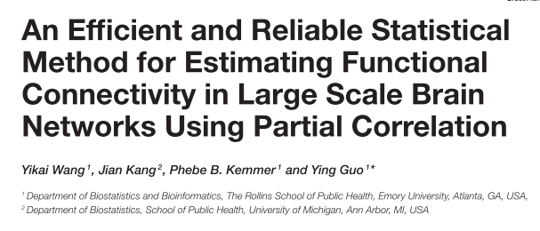
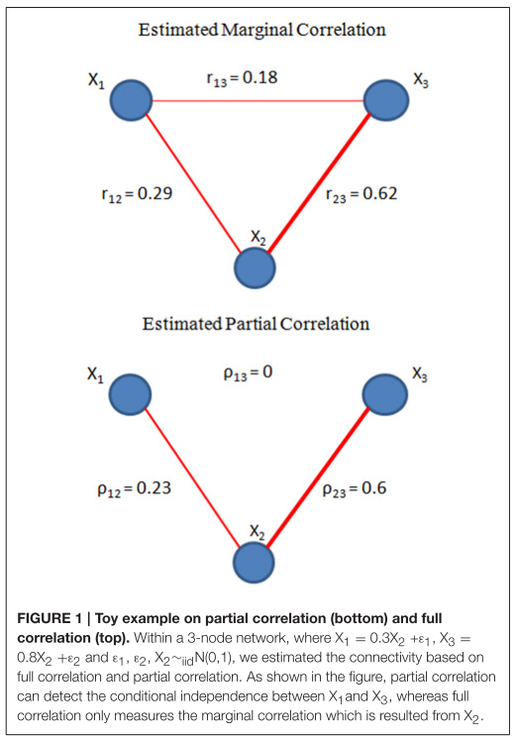
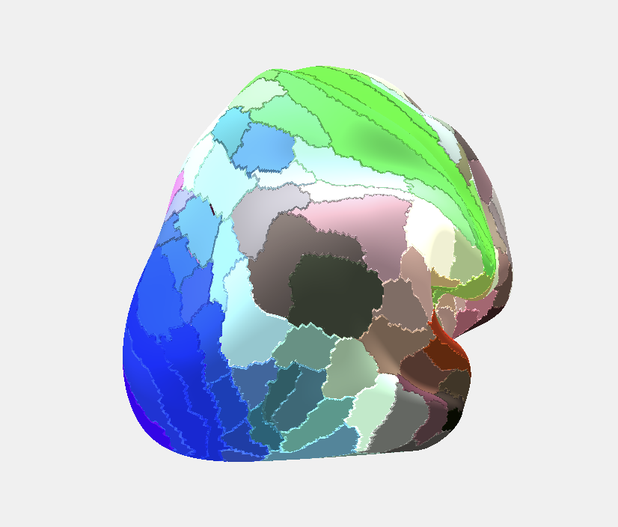

Slide 18
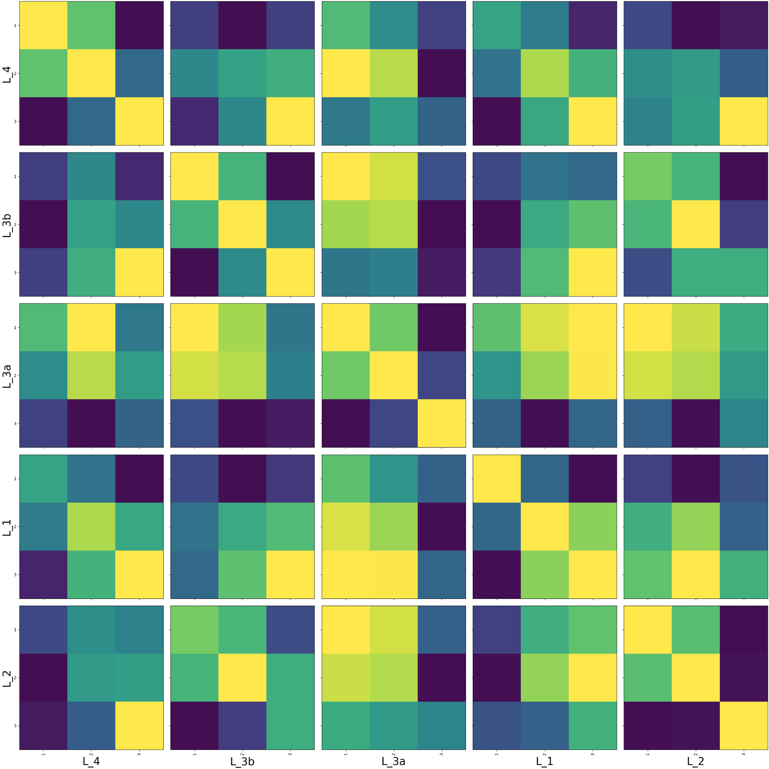
Statistics?

Slide 19
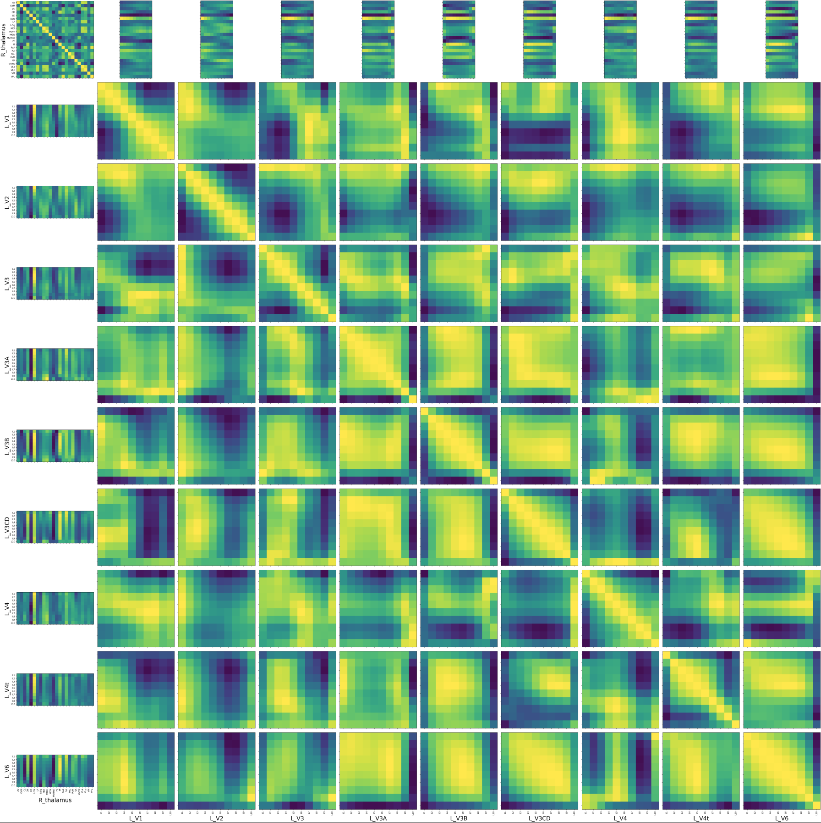

Slide 20
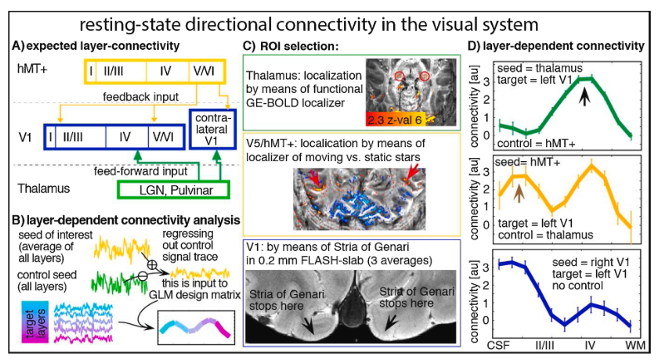

Slide 21
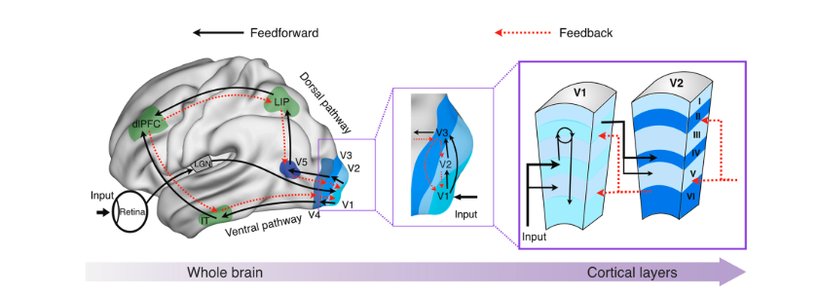
Why layers and columns?

Slide 22
